Slide 1
Exercise 3

Slide 2
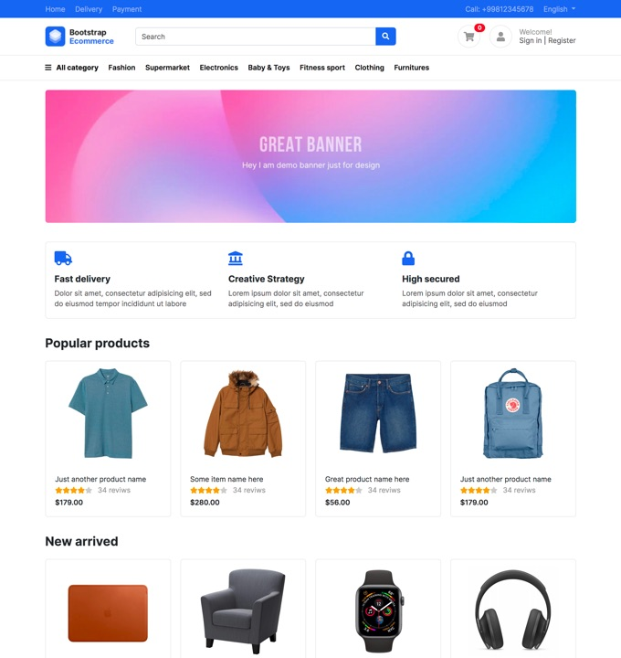
Define the component on this template

Slide 3
TODO: Define and draw components
Menu component
menu
menu
contact
Banner component
Title
paragraph

Slide 4
Navigation bar component
Draw Navigation bar component
Main menu component
logo
Title
Button
icon
text
Text
Text
Text
Text
Draw Main menu component

Slide 5
Column component
logo
logo
logo
Title
Title
Title
paragraph
paragraph
paragraph
Draw Column component

Slide 6
Title
image
image
image
image
Title
image
image
image
image
Body-column component

Slide 7
Draw card component
image
image
Text
Card component

